Slide 1

AI Powered Spam Classifier
Department Of Electronics and Communication
Team Mates:
P.BalaPrakash
S.Logeshwaran
J.Kishore Kumar
S.Bhuvanesh
V.Abishek
Team Name:
Tech_Finders

Slide 2
Problem Definition:
AI-powered spam classification is a computational task in which machine learning models are employed to automatically discern and categorize unsolicited or undesirable messages, such as spam emails or comments, from legitimate and relevant ones.
This problem involves training algorithms to analyze various features and patterns within textual or multimedia content to distinguish between spam and non-spam.
These features may include keywords, sender information, message structure, and user behavior.
By continuously learning from new data, AI spam classifiers adapt and improve their accuracy over time, enhancing the efficiency of email inboxes, social media platforms, and other digital communication channels by filtering out unwanted content and safeguarding users from potentially harmful or irrelevant information

Slide 3
Objectives:
Training Data A diverse dataset of labeled emails, including both spam and legitimate messages, to train the AI model
Machine Learning Model: The core AI algorithm that learns from the training data and classifies incoming emails as spam or not.
Feature Extraction Tools: Methods to extract relevant features from email content, such as text analysis and sender information.
User Feedback Mechanism: A way for users to report false positives and false negatives to continually improve the classifier's accuracy.
APIs: If applicable, APIs for developers to integrate the classifier into custom applications or services.

Slide 4
Algorithm For Scaning Mail:
Support Vector Machines (SVM): Separates spam from non-spam emails in high-dimensional space.
Decision Trees: Creates models by analyzing email attributes.
Random Forests: Enhances accuracy through ensemble learning.
Neural Networks: Extracts complex features for classification.
K-Nearest Neighbors (K-NN): Classifies emails by similarity.
Logistic Regression: Estimates spam probability from various features.
Ensemble Methods: Combines model predictions for improved accuracy.
Deep Learning (LSTM, Transformers): Advances content-based spam detection.
Feature Engineering: Extracts relevant email attributes for analysis.

Slide 5
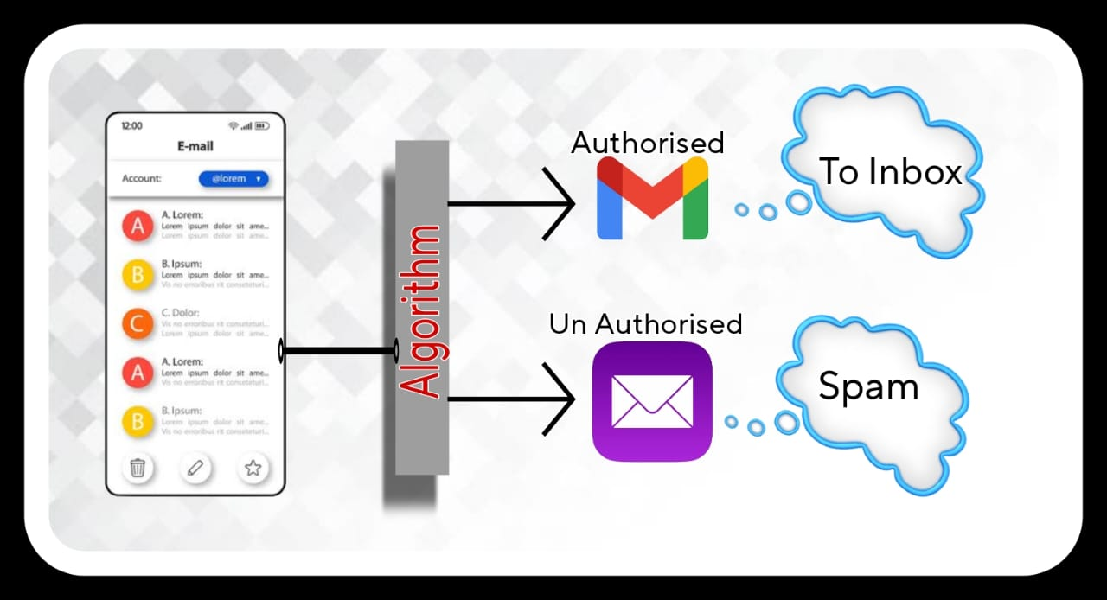
Flow Chart:

Slide 6
Mail Finding Approach:
Indicators of Legitimate Emails:
Known Senders: Emails from trusted contacts or subscribed companies are typically genuine.
Expected Content: Legitimate emails align with your interests or prior interactions.
Correct Spelling and Grammar: Genuine emails maintain proper language.
Personalization: Legitimate emails address you by name and reference past interactions.
Consistent Sender Information: Verify the sender's domain matches their claimed organization.
No Urgent Language: Authentic emails avoid threats or undue pressure.

Slide 7
Indicators of Spam Emails:
Unknown Senders: Suspicious or unfamiliar email addresses often signal spam.
Language Errors: Spam emails may contain grammatical mistakes.
Generic Greetings: Watch for vague salutations like "Dear User.“
Unsolicited Attachments/Links: Be cautious with unfamiliar attachments or links.
Info Requests: Legitimate entities won't seek sensitive data via email.
Too Good to Be True: Be wary of unbelievable offers.
Phishing URLs: Hover over links to verify their legitimacy.
Unexpected Content: Irrelevant topics may indicate spam.
Urgency: Emails pressuring immediate action could be spam.
Unsolicited Subscriptions: If you didn't subscribe, it's likely spam.

Slide 8
Benefits:
Enhanced Security: Identifying spam emails safeguards personal and sensitive information, protecting users from phishing scams, identity theft, and malware.
Time Savings: Filtering out spam ensures that users only spend time on genuine and relevant messages, increasing productivity.
Reduced Clutter: By removing spam, inboxes remain organized and manageable, making it easier to find important emails.
Improved Email Performance: Lowering the volume of spam reduces the strain on email servers, leading to faster and more reliable email services.
Preventing Miscommunication: Accurate email sorting helps prevent important messages from being overlooked or lost in a sea of spam, fostering effective communication.
Cost Savings: Less spam reduces data usage and lowers the risk of falling for fraudulent offers, resulting in potential financial savings.

Slide 9
THANK YOU !!!

